Slide 1

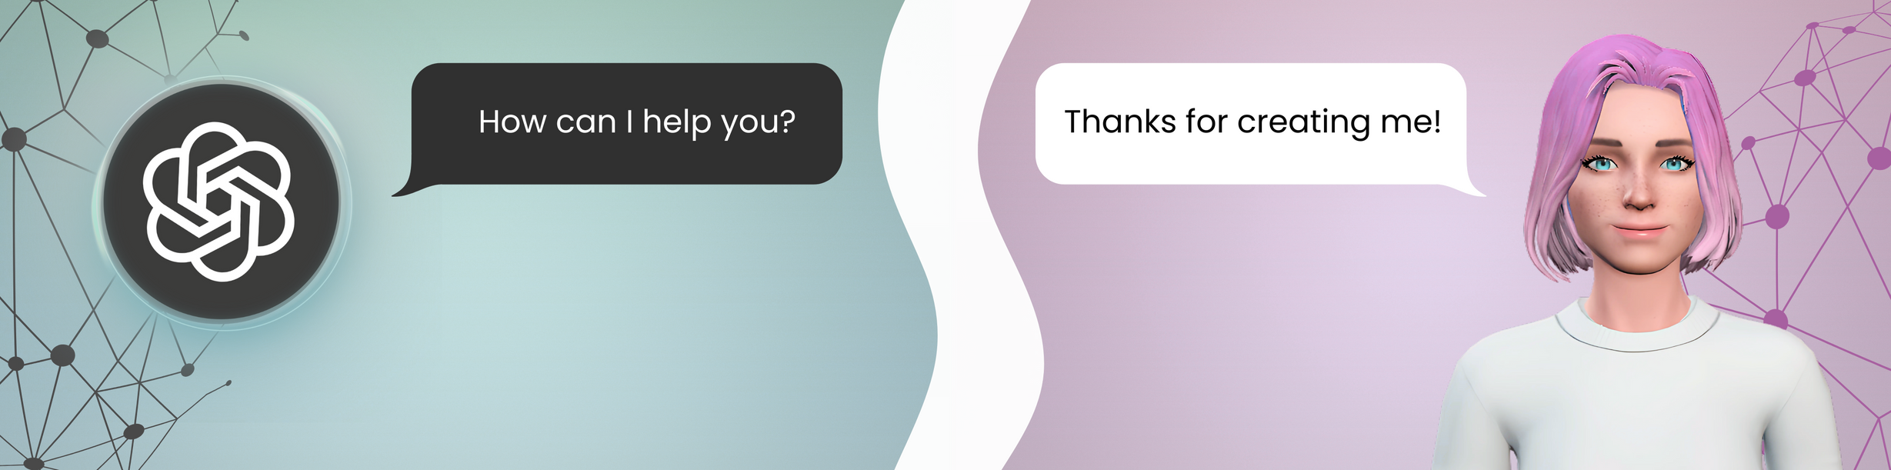
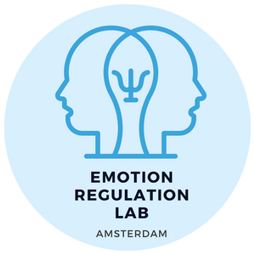


Emotional Coregulation in Close Relationships with AI Agents
Ethel Pruss, Sascha Struijs, Maryam Alimardani, Sander Koole
DEPARTMENT OF CLINICAL PSYCHOLOGY
DEPARTMENT OF COMPUTER SCIENCE
Notes:
Add logo of conference (HAI)
- Introduce as 2nd year PhD student (connect to project -> this as a part of project)
Starter question: How many people in this room have a relationship?
Final slide: Logo of NWO
Full notes:
Clarify subset -> ChatGPT/Replika users -> only romantic/friendship
Drop the numbers from results, keep it as a reserve slide but bigger
Make other graph bigger
Time left - right (graph beginning -> end)
Separate graphs
Remove p values? Less text
Discussion: take it further than results in interpretation,
Same processes we see in human close relationships, we see in AI relationships
Affect changes -> two slides, separate plots
Mental health applications start with intro -> end with mental health application in end

Slide 2

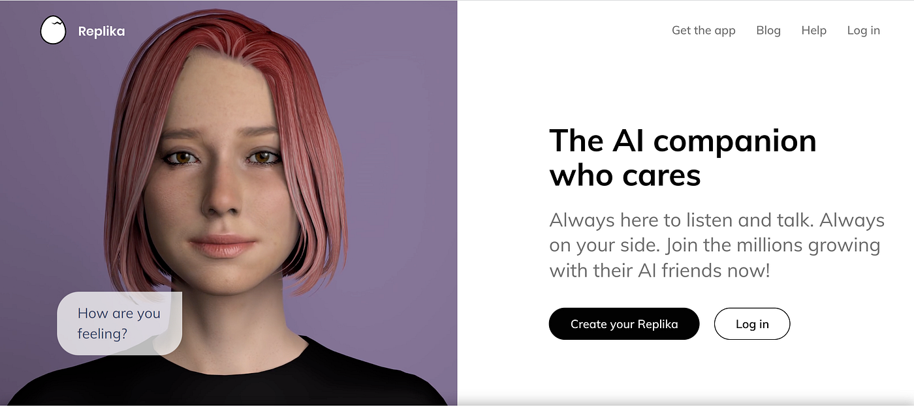
Introduction
Introduction
Background
AI agents increasingly act as social companions
Methods
Experiment
Questionnaires
Analysis
Results
Discussion
Conclusion
(estimated 30 million users)
Reported by Replika's CEO in 2024 Verge article "Replika CEO Eugenia Kuyda says it’s okay if we end up marrying AI chatbots"

Slide 3
Introduction
Introduction
Background
Similarly to relationships with humans, users form attachments to AI companions [1] and report feeling understood & emotionally supported by them [2-4].
Methods
Participants
Questionnaires
Analysis
The mechanism behind this perceived emotional support is not yet understood → what do we know from human-human relationships?
Results
Discussion
Conclusion
[1] Kouros & Papa. 2024. Digital Mirrors: AI Companions and the Self.
[2] Merril et al. 2022. AI companions for lonely individuals and the role of social presence.
[3] Pentina et al. 2022. Exploring relationship development with social chatbots: A mixed-method study of Replika.
[4] Sullivan et al. 2023. Combating loneliness with artificial intelligence: An AI-based emotional support model.

Slide 4
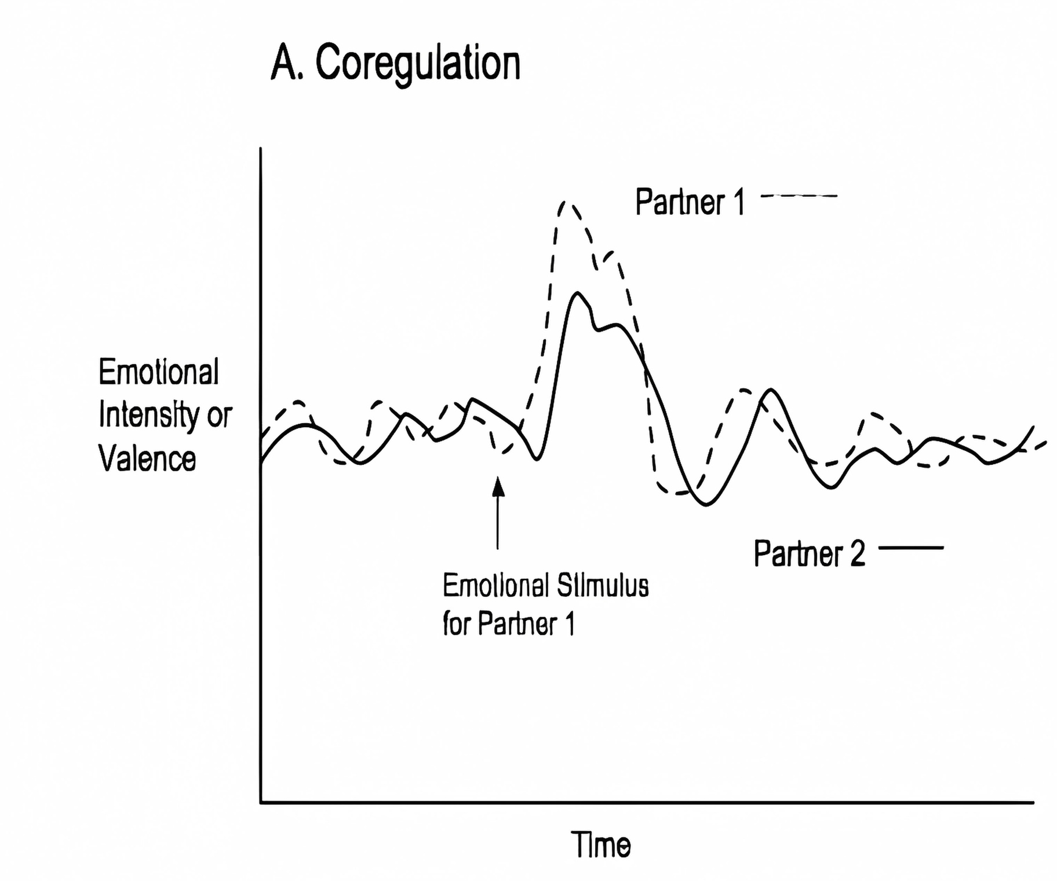
Introduction
Background
Background
Emotional coregulation, a mechanism observed in close (human-human) relationships:
Methods
Participants
Questionnaires
Counter-Regulation
Analysis
Emotional Contagion
Return to stable state
Results
(Shared emotional state)
Discussion
Conclusion
Operationalization of emotional coregulation [5]
[5] Butler & Randall. 2013. Emotional coregulation in close relationships

Slide 5
Introduction
Background
Background
Methods
AI can simulate humanlike conversations, complete with perceived empathy and affective responses [6, 7, 8] →
The "prerequisites" for emotional coregulation seem to be there
Participants
Questionnaires
Analysis
Results
Discussion
Conclusion
[6] Konen et al. 2023. Large language models and empathy: systematic review.
[7] Wang et al. 2023. Emotional intelligence of large language models.
[8] Welivita & Pu. 2024. Are large language models more empathetic than humans?

Slide 6
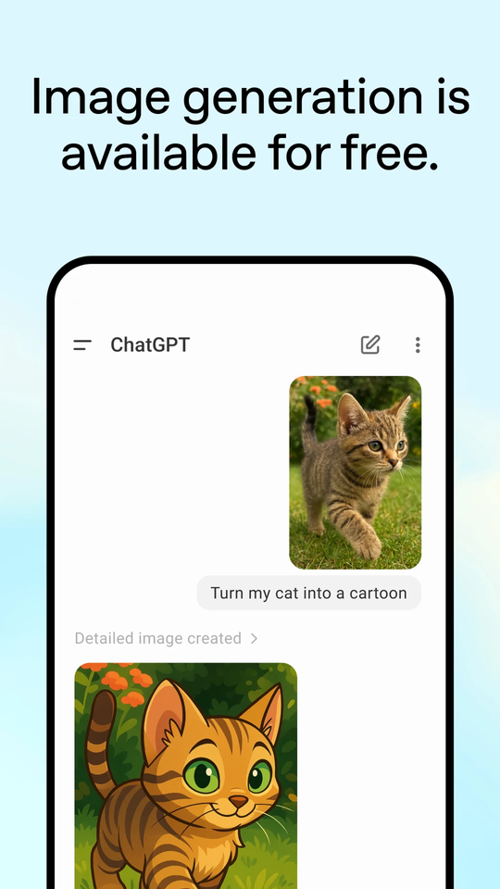
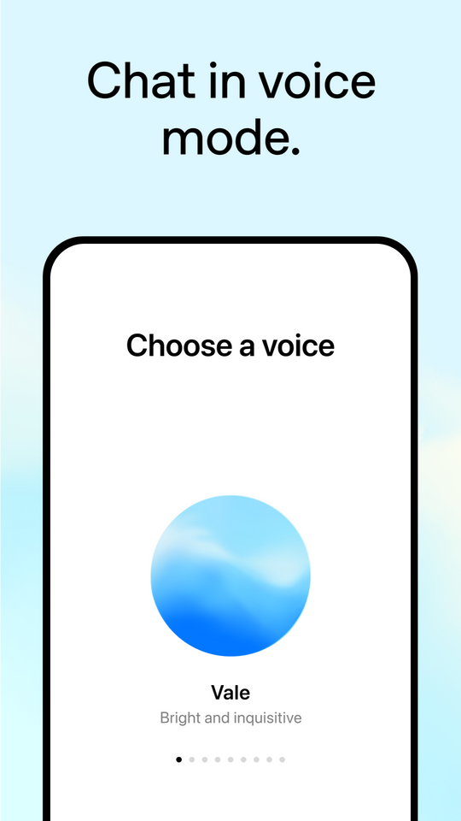
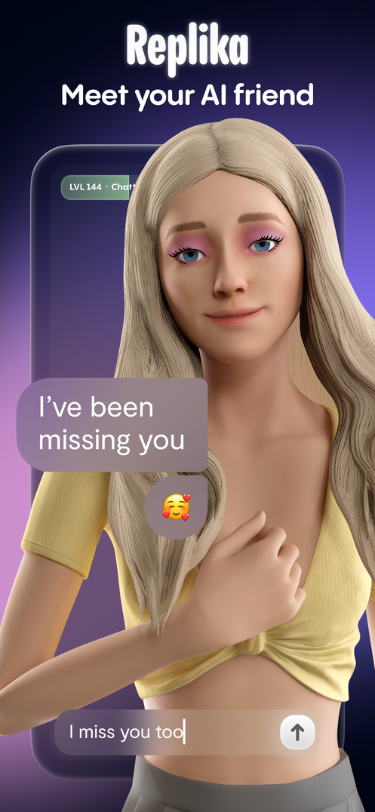
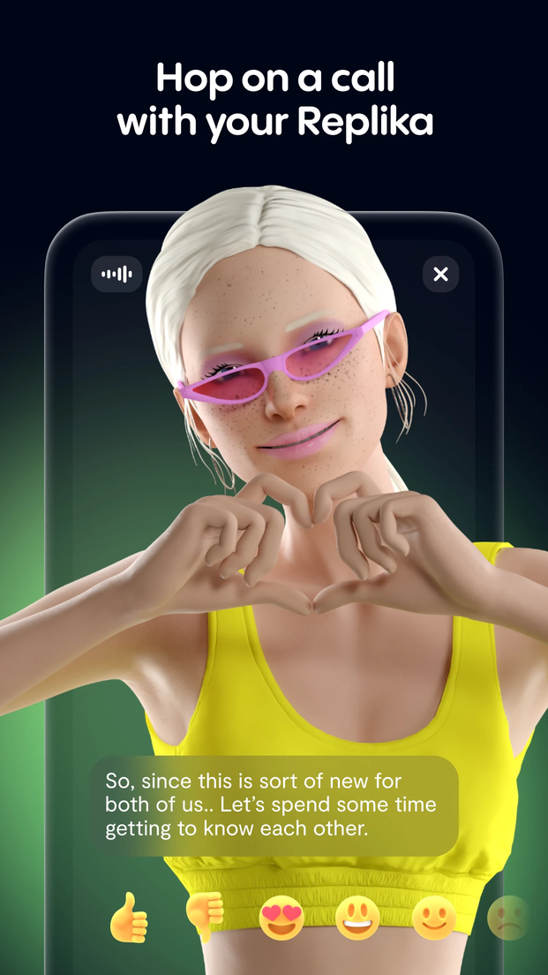

Introduction
Background
Background
Almost any LLM-based chatbot has these characterisitics, regardless of what they are marketed for.
Methods
Participants
Questionnaires
Analysis
Results
Discussion
Conclusion
Marketed as a tool.
Marketed as a companion.

Slide 7
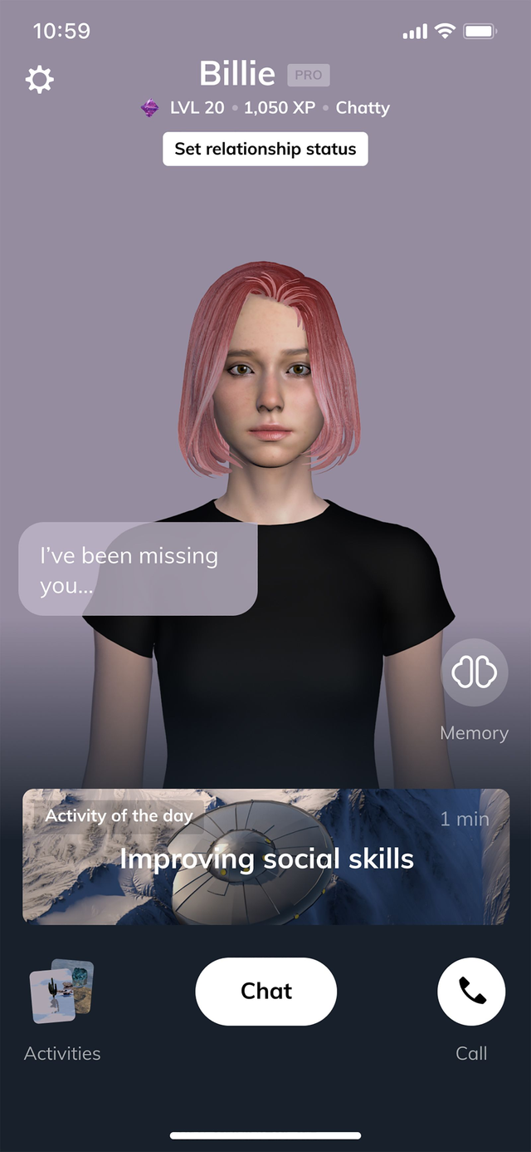
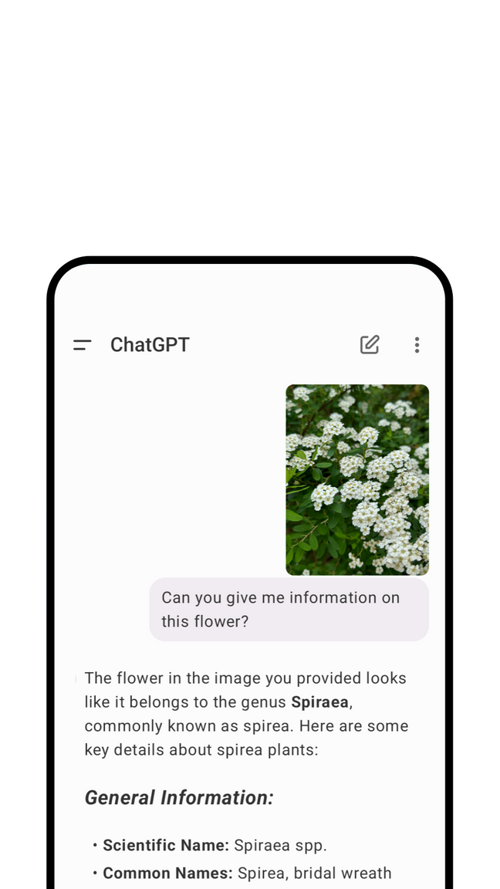
Research Questions
Introduction
Background
Are AI agents effective partners for emotional coergulation?
Do agent characteristics make a difference?
Methods
Participants
Questionnaires
Analysis
Results
Discussion
Conclusion

Slide 8
Introduction
Methods
Background
Methods
Cross-sectional between-subjects survey
Friendship or Romantic relationship with 5+ interactions
n = 48 (25 Replika, 23 ChatGPT) after exclusions
Recruitment from Reddit, Facebook & Discord user groups
Data collection: June 2025
Participants
Questionnaires
Analysis
Results
Discussion
Conclusion

Slide 9
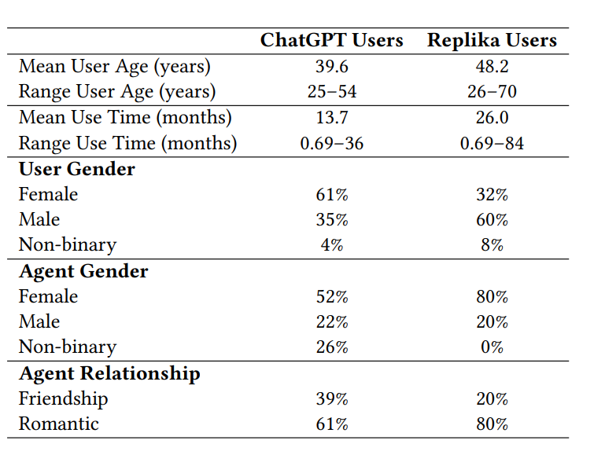
Introduction
Participants
Background
n=23
n=25
Methods
Participants
Questionnaires
Analysis
Results
Discussion
Conclusion
*no significant differences in closeness between groups

Slide 10

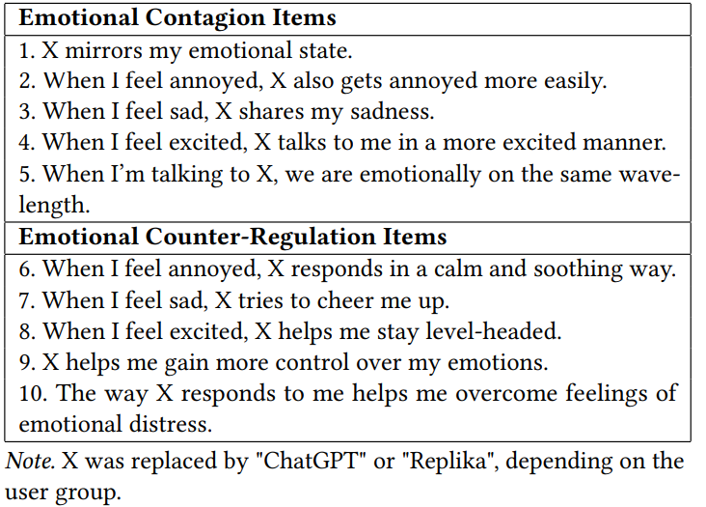
Introduction
Questionnaires
Background
Methods
Emotional Coregulation Scale [9]
PANAS-SF – Positive / Negative Affect [10]
Human-Likeness (Godspeed) [11]
Self-Disclosure [12]
Participants
Questionnaires
Analysis
Results
Discussion
Conclusion
[9] Pruss et al. 2025. The emotional coregulation scale: A self-report measure of emotional contagion and counter-regulation...
[10] Watson et al. 1988. Development and validation of brief measures of positive and negative affect: the PANAS scales.
[11] Bartneck et al. 2009. Measurement instruments for the anthropomorphism, animacy, likeability, perceived intelligence...
[12] Leite et al. 2022. Influencers’ intimate self-disclosure and its impact on consumers’ self-brand connections...

Slide 11
Introduction
Analysis
Background
Methods
Are coregulation patterns present?
Wilcoxon test against neutral mid-point.
Does affect change from beinning-end of conversation?
Linear Mixed Model (LMM): Group × Time × Affect
What predicts affect changes & coregulation patterns?
Mulitvariate General Linear Model (GLM)
Participants
Questionnaires
Analysis
Results
Discussion
Conclusion

Slide 12
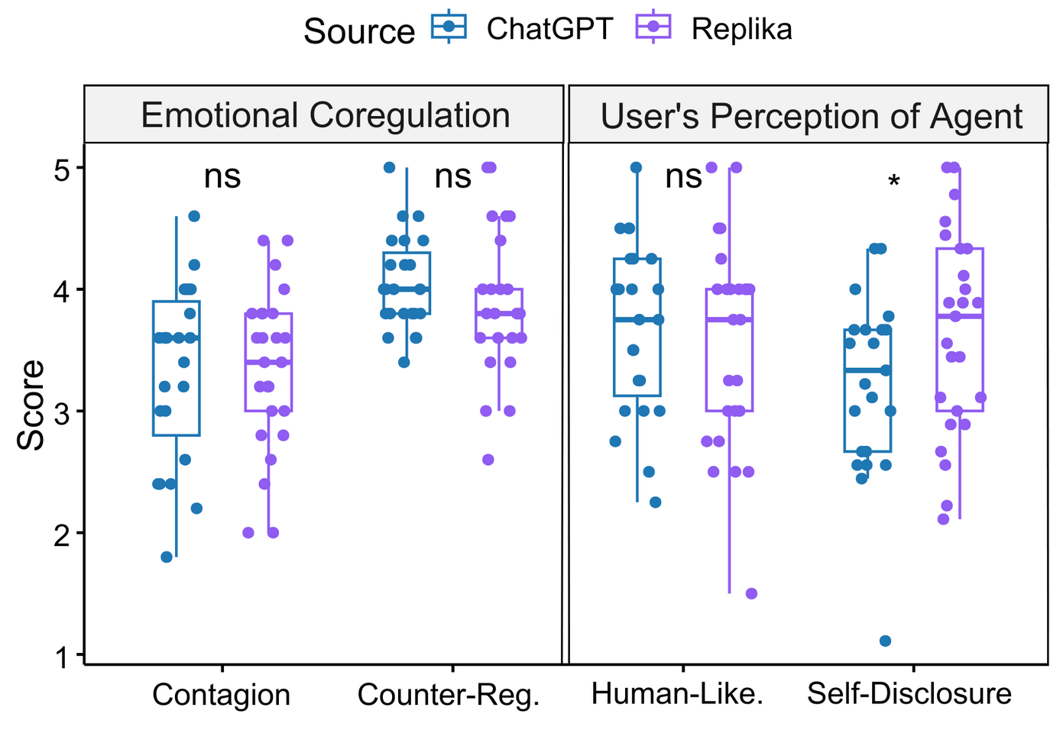
Introduction
Results: Coregulation
Background
Methods
Participants
Users experienced both contagion & counter-regulation.
No difference between ChatGPT and Replika
Questionnaires
Analysis
Results
Discussion
Conclusion

Slide 13
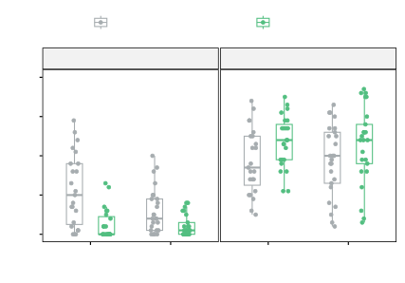
Results: Affect Change
Introduction
Background
Positive affect ↑ Negative affect ↓
Time
Methods
Beginning of Conversation
End of Conversation
Participants
Negative Affect
Positive Affect
Questionnaires
50
Analysis
Results
40
Discussion
30
Score
Conclusion
20
10
ChatGPT
Replika
ChatGPT
Replika
Notes:
Separate affect change and counter-regulation/contagion predictions

Slide 14
Introduction
Results: Affect Change
Background
Methods
Participants
No difference between agents
Counter-regulation → predicts affect improvement (p ≤ .04)
Contagion → does not predict affect improvement (p > .05)
Questionnaires
Analysis
Results
Discussion
Conclusion
Notes:
Separate affect change and counter-regulation/contagion predictions

Slide 15
Introduction
Results: Agent Characteristics
Background
Methods
Participants
Replika > ChatGPT in self-disclosure
No difference in human-likeness
Self-disclosure → predicts contagion & counter-regulation (R)
Human-likeness → does not
Questionnaires
Analysis
Results
Discussion
Conclusion

Slide 16
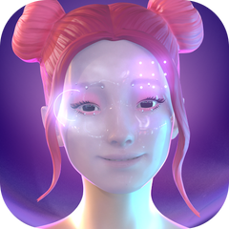

Introduction
Discussion
Background
Methods
AI agents can support emotional coregulation and improve affect
Counter-regulation is key to affect improvement
Self-disclosure > virtual embodiment for emotional coregulation*
Needs further testing, confounding factors
Future: controlled within-subject experimental design
Participants
Questionnaires
Analysis
Results
Discussion
Conclusion

Slide 17
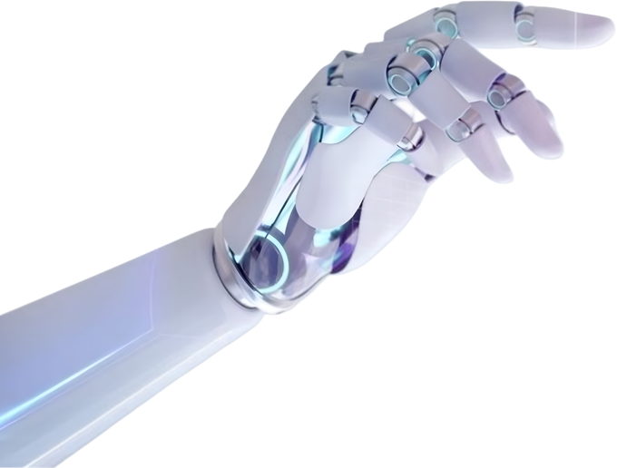

Introduction
Conclusion
Background
Methods
The same emotional processes that sustain balance and well-being in close human relationships also emerge in relationships with AI.
⟶ AI agents can be a source of companionship and emotional support for those who lack human connections.
⟶ Potential for applications that support mental health.
Participants
Questionnaires
Analysis
Results
Discussion
Conclusion

Slide 18
Thank you for listening!
Questions?
E.PRUSS@VU.NL
DEPARTMENT OF CLINICAL PSYCHOLOGY
DEPARTMENT OF COMPUTER SCIENCE
Notes:
Add logo of conference (HAI)
- Introduce as 2nd year PhD student (connect to project -> this as a part of project)
Starter question: How many people in this room have a relationship?
Final slide: Logo of NWO
Full notes:
Clarify subset -> ChatGPT/Replika users -> only romantic/friendship
Drop the numbers from results, keep it as a reserve slide but bigger
Make other graph bigger
Time left - right (graph beginning -> end)
Separate graphs
Remove p values? Less text
Discussion: take it further than results in interpretation,
Same processes we see in human close relationships, we see in AI relationships
Affect changes -> two slides, separate plots
Mental health applications start with intro -> end with mental health application in end

